Slide 1
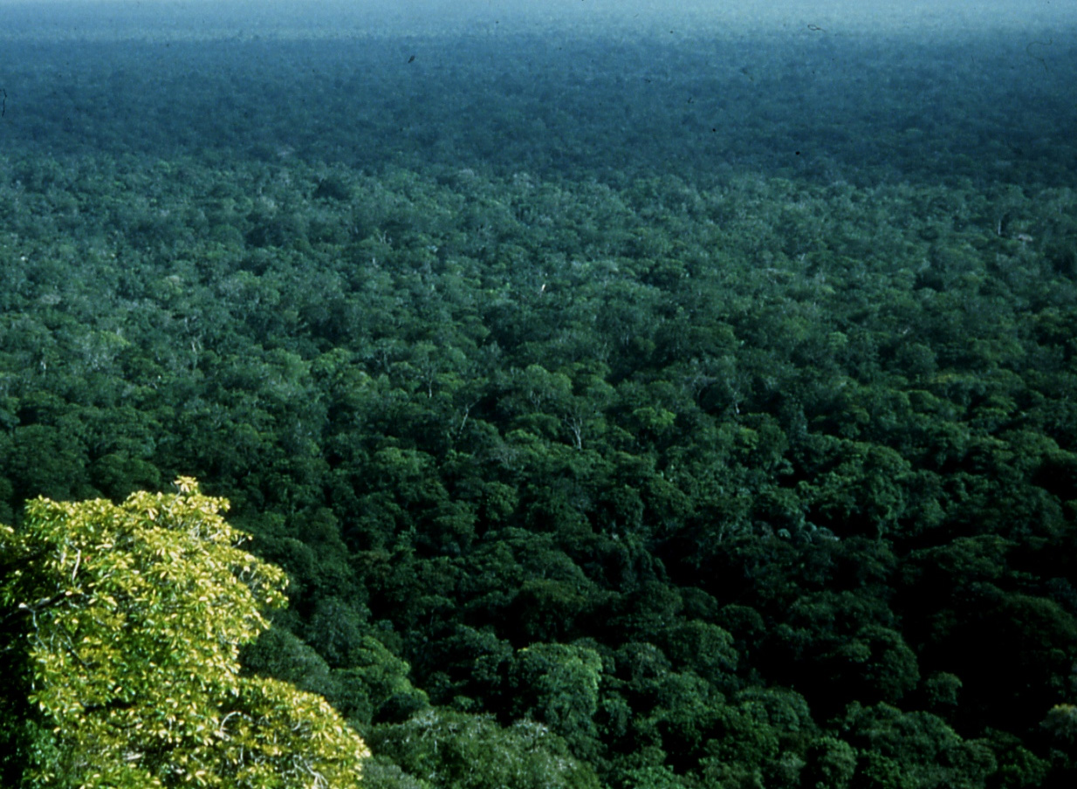
Engaging Incarcerated Adults and Youth in Care with
Science and Conservation: Synergisms with Academia
Nalini Nadkarni and Allison Anholt
Department of Biology
University of Utah
Notes:
On of my favorite poets, the Indian write, Rab tagore, wrote:The tapesty of life’s story is woven with the threads of life’s ties, ever breaking and joining.
So today will take a look at one of life’s tapestry – forest ecosystems – and examine those threads.
Start by introducing myself, my background, my research
Discuss ways of communicating, espec to non-traditional audiences,
Put some thoughts out on why trees are so special
End with an exercise to articulate our favorite trees, and the threads that might join in discovering that.

Slide 2
How might academic scientists interact synergistically
With incarcerated adults and youth-in-care?
Notes:
On of my favorite poets, the Indian write, Rab tagore, wrote:The tapesty of life’s story is woven with the threads of life’s ties, ever breaking and joining.
So today will take a look at one of life’s tapestry – forest ecosystems – and examine those threads.
Start by introducing myself, my background, my research
Discuss ways of communicating, espec to non-traditional audiences,
Put some thoughts out on why trees are so special
End with an exercise to articulate our favorite trees, and the threads that might join in discovering that.

Slide 3
Scientific background
Programs for youth-in-care
Future plans
Your input!
Notes:
On of my favorite poets, the Indian write, Rab tagore, wrote:The tapesty of life’s story is woven with the threads of life’s ties, ever breaking and joining.
So today will take a look at one of life’s tapestry – forest ecosystems – and examine those threads.
Start by introducing myself, my background, my research
Discuss ways of communicating, espec to non-traditional audiences,
Put some thoughts out on why trees are so special
End with an exercise to articulate our favorite trees, and the threads that might join in discovering that.

Slide 4
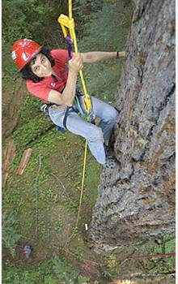
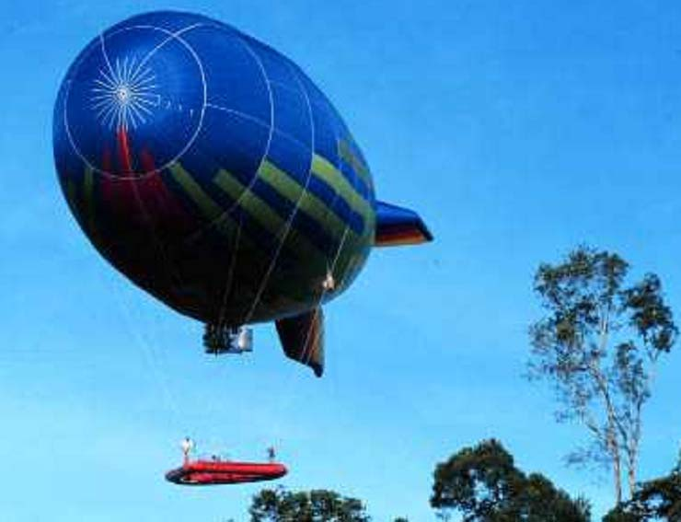
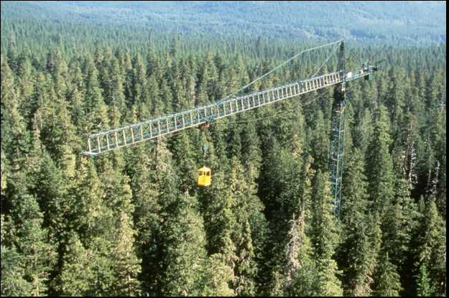

Slide 5
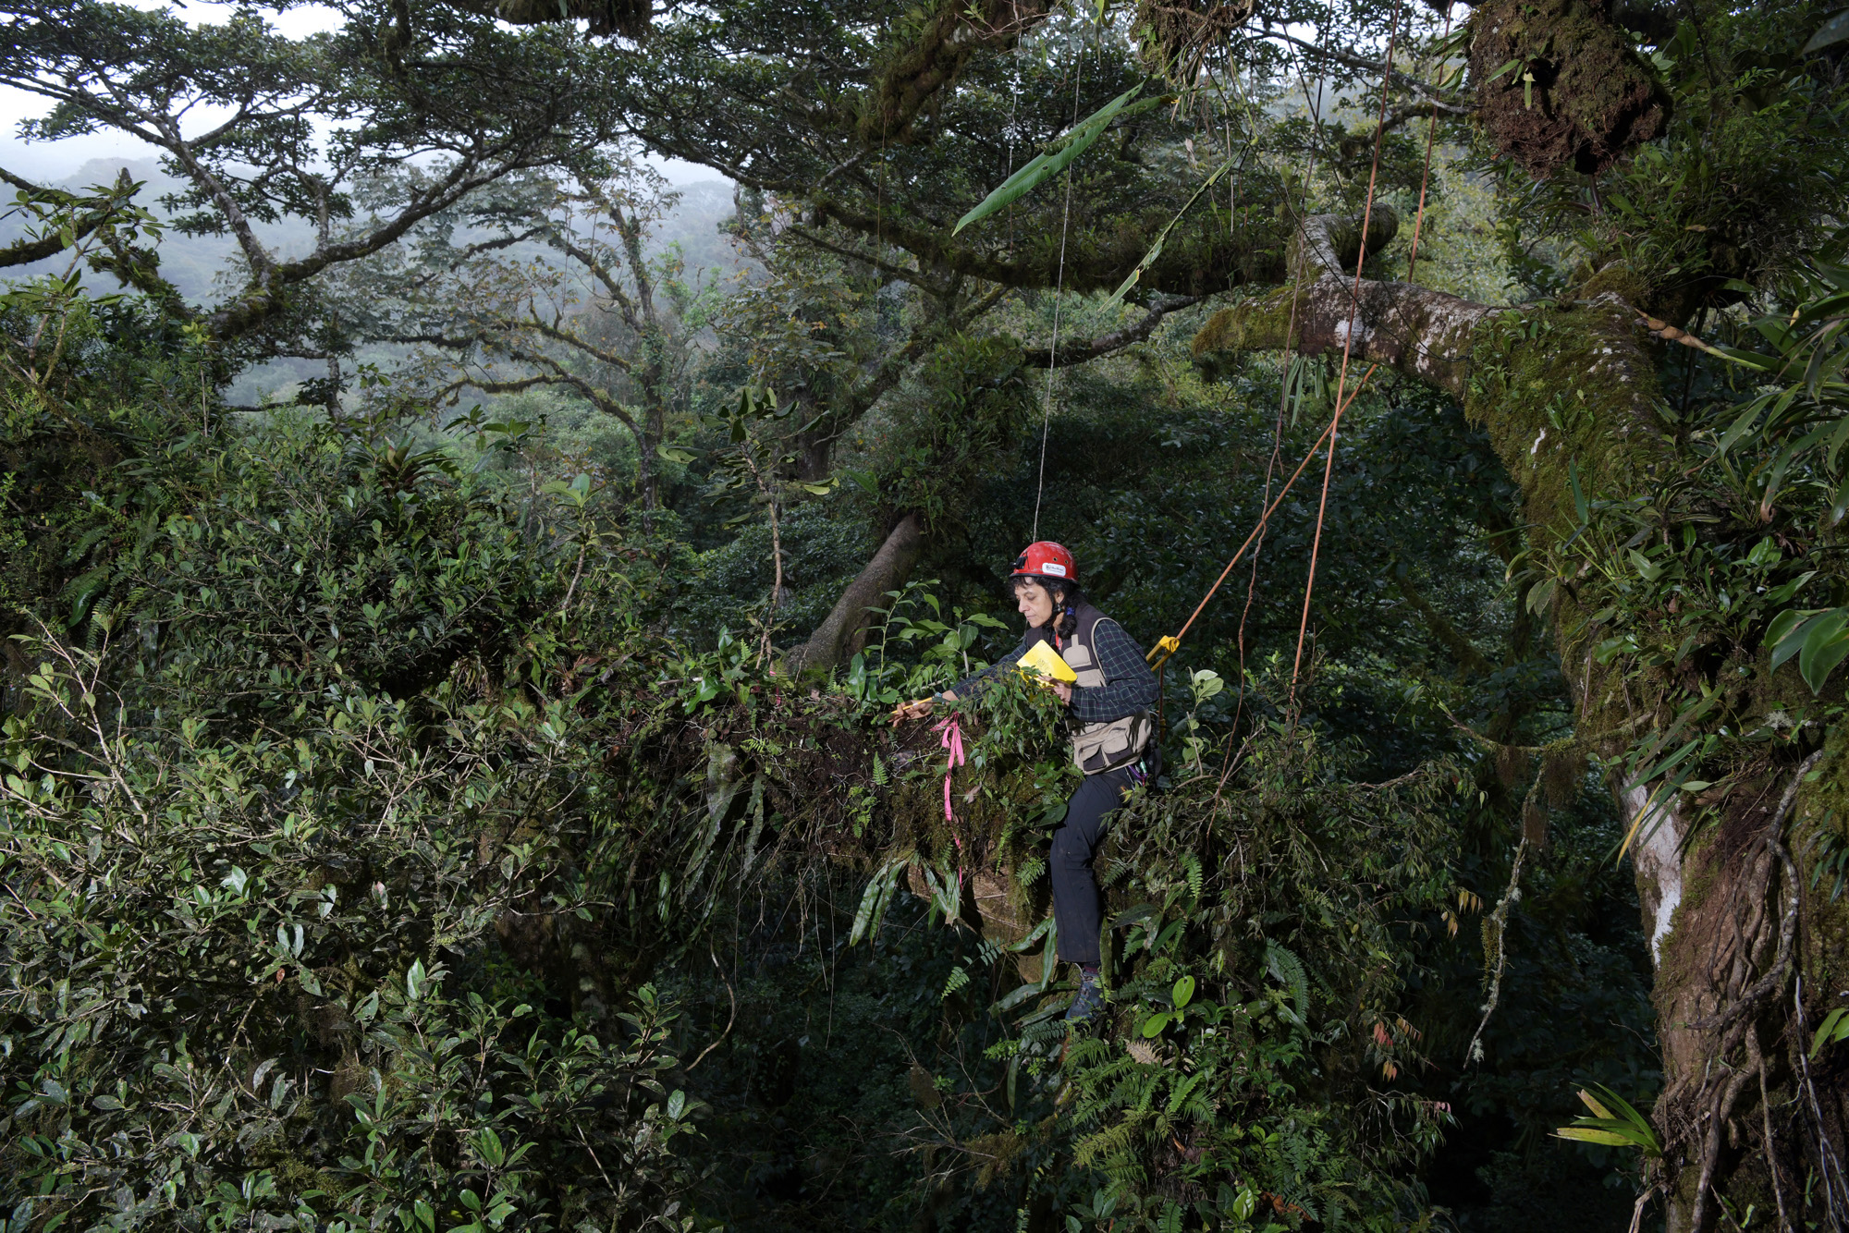

Slide 6
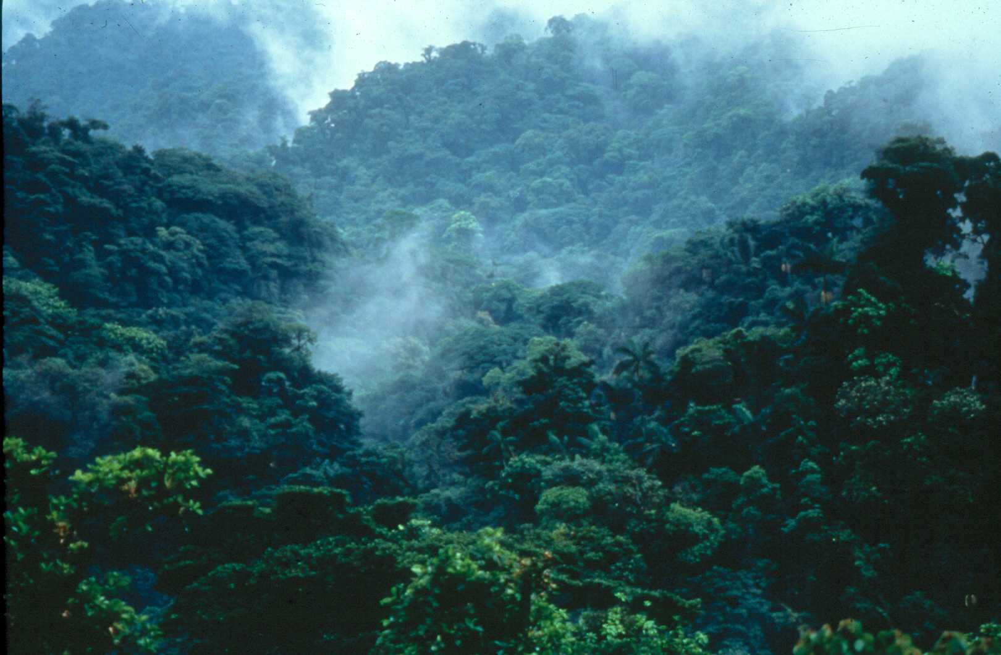
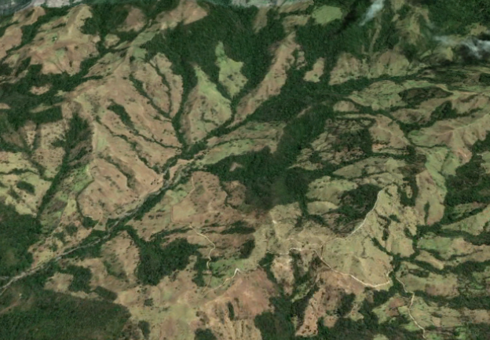
Notes:
Other research shows that canopies of world forests represent the largest pool of stored carbon of any terrestrial ecosystem, sequestering carbon from the atmosphere. This contributes to keep world climate stable.

Slide 7
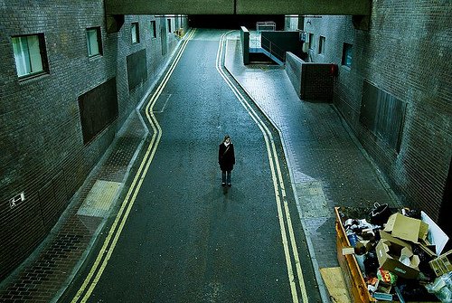

Slide 8
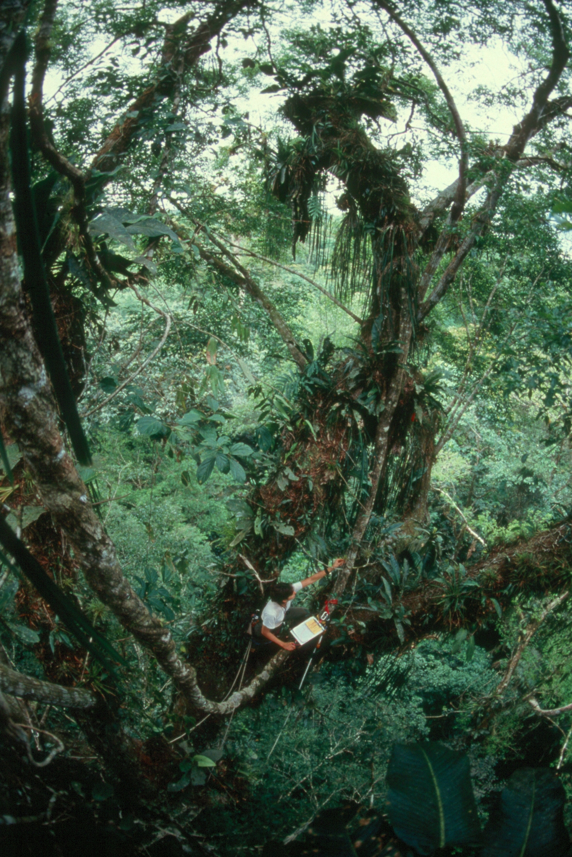
Notes:
Eventually chose fielwork and scinece to understand the world

Slide 9

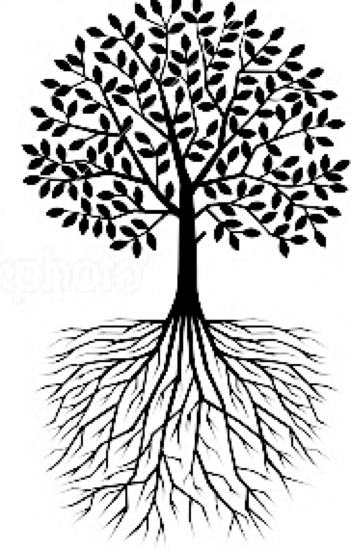
Conservation
Projects
Science
Lectures
Nature
Imagery
Academic Science
Conservation
Notes:
Overall structure: the CSME serves as a unique conduit. It is firmly routed in higher ed (science and education), and the public (formal and informal science education pathways). Assessment and evaluation are applied throughout; and though most projects are local and regional, we keep extension to national scales in mind.

Slide 10

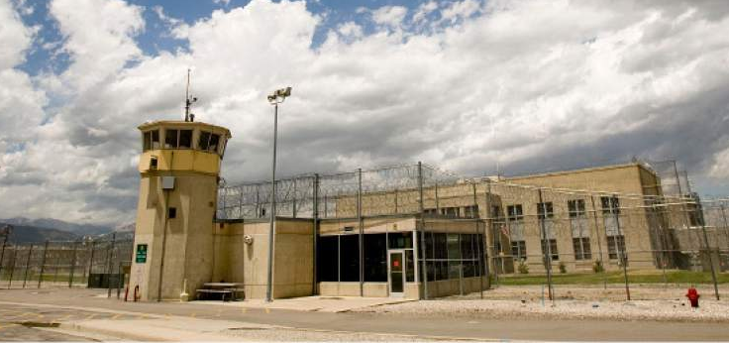
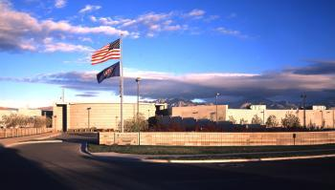
MISSION:
…to bring science lectures, conservation projects,
and nature imagery to people who are incarcerated in Utah
and other corrections facilities.

Slide 11
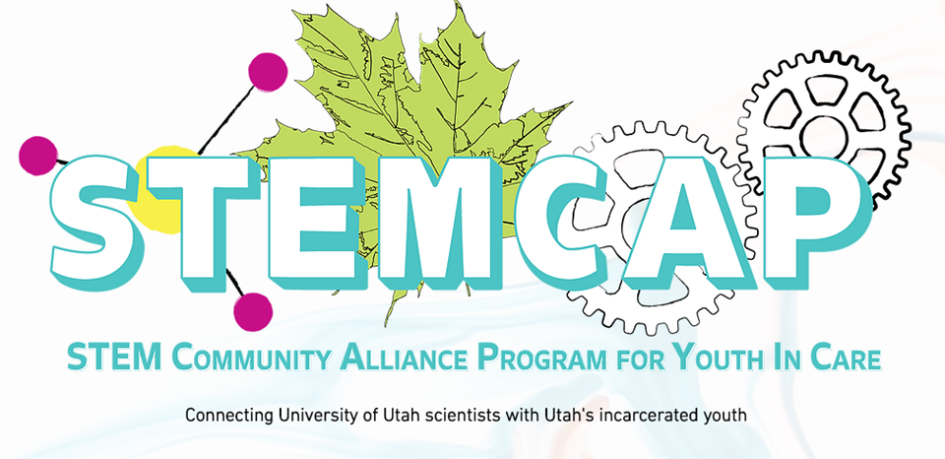
Decker Lake
Girls Transition Center
Slate Canyon
Farmington Bay
Genesis Youth Center

Slide 12
Conservation
Projects
Science
Lectures
Nature
Imagery
Academic Science
Conservation
Notes:
Overall structure: the CSME serves as a unique conduit. It is firmly routed in higher ed (science and education), and the public (formal and informal science education pathways). Assessment and evaluation are applied throughout; and though most projects are local and regional, we keep extension to national scales in mind.

Slide 13
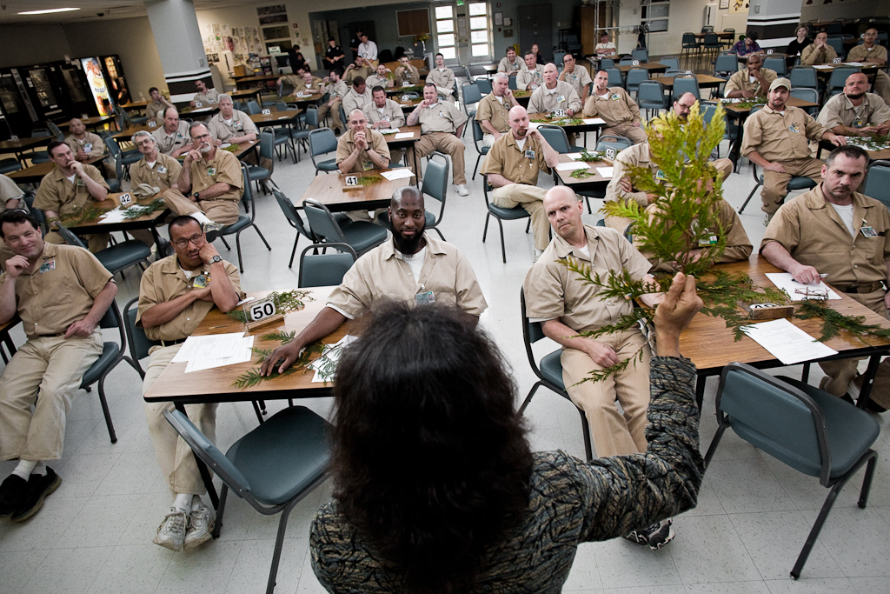

Slide 14
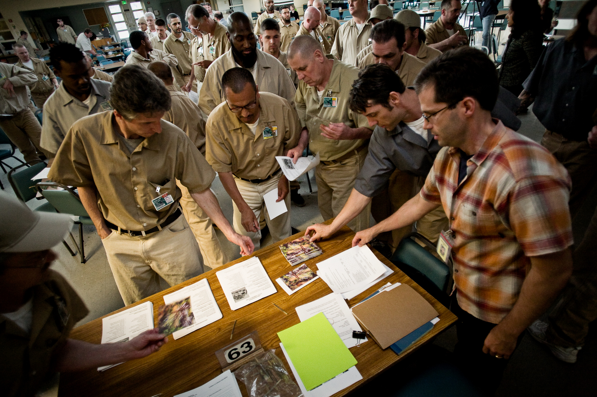
Notes:
We also provide paper handouts of materials that are relevant to each lecture so that the offenders can learn more about the topic on their own time. These materials are eagerly taken, no matter what the topic.

Slide 15
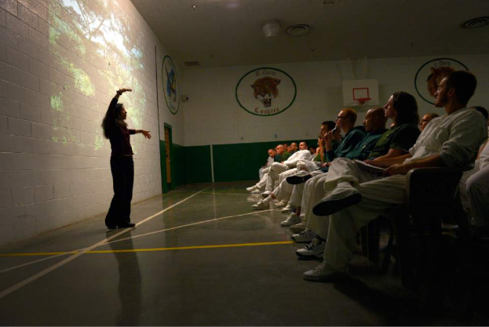
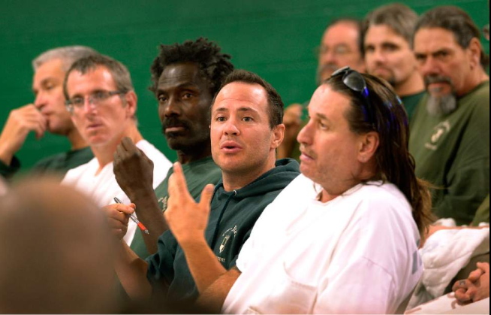
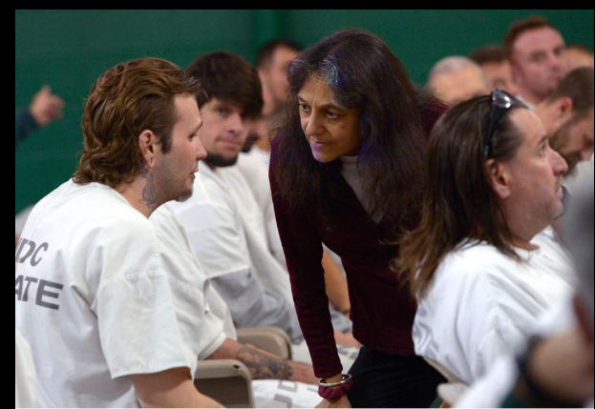

Slide 16
Science Lecture Topics, Draper State Prison
2016-2018
Zoology
Cone snail venom
Studying memory in worms
Diversity of ants
Ecology of pikas
Gray wolf biomechanics
Bird anatomy
Bird migration
Conservation of wolves and bears
Human biology and health
Human gut bacteria
Physics of the human voice
Inactivity and human health
Diabetes
Chemistry of cancer treatments
Botany
Trees and people around the world
Microbial biology
Antibiotic resistance in microbes
Structure of viruses
Ecology
Watersheds
Interactions between ants and plants
Extreme adaptations
Parasites

Slide 17
Percent of responses
Content
Attitude
Behavior

Slide 18
Conservation
Projects
Science
Lectures
Nature
Imagery
Academic Science
Conservation
Notes:
Overall structure: the CSME serves as a unique conduit. It is firmly routed in higher ed (science and education), and the public (formal and informal science education pathways). Assessment and evaluation are applied throughout; and though most projects are local and regional, we keep extension to national scales in mind.

Slide 19
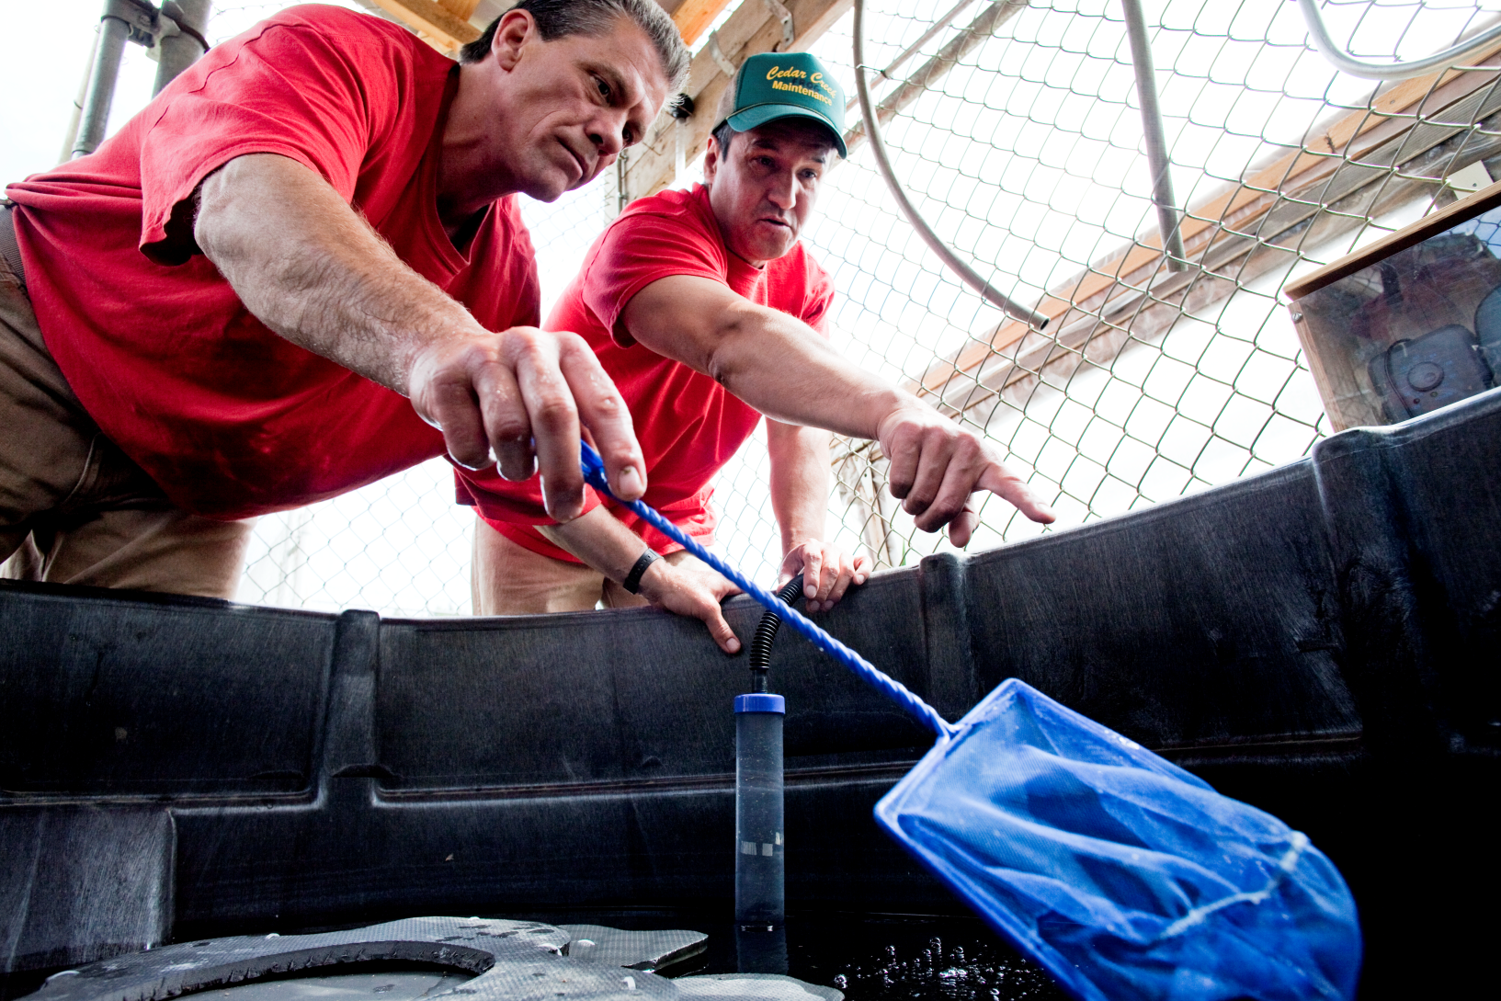
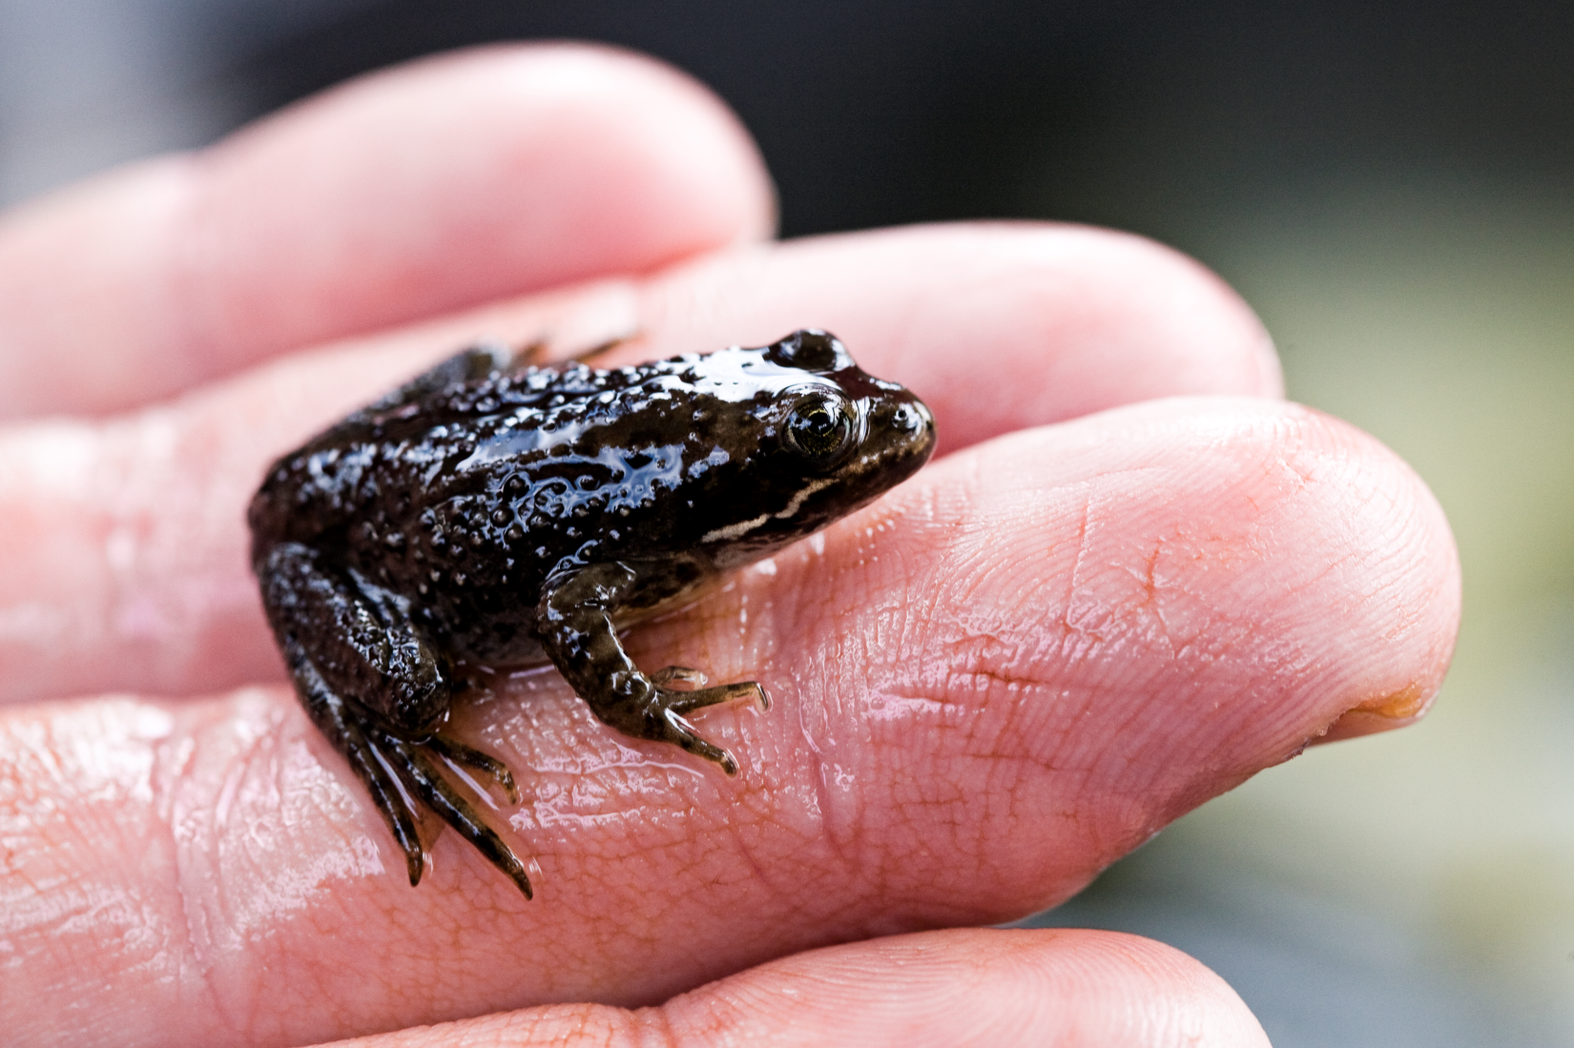
Oregon Spotted Frog
Notes:
Offenders at Cedar Creek Corrections Center, seen here, are rearing nearly 200 endangered Oregon spotted frogs this year.
Over the last three seasons they have consistently grown frogs to maturity in one season and raised significantly larger frogs than the trained professionals at three other zoos doing the same work.
A team including a Senior Scientist at the WA State Department of Fish and Wildlife, a graduate student intern, and a staff member at the Correction Center support the offenders with the captive rearing and research projects.
They have raised over 160 frogs to adulthood and achieved a remarkably high 85%+ survivorship each year
19

Slide 20
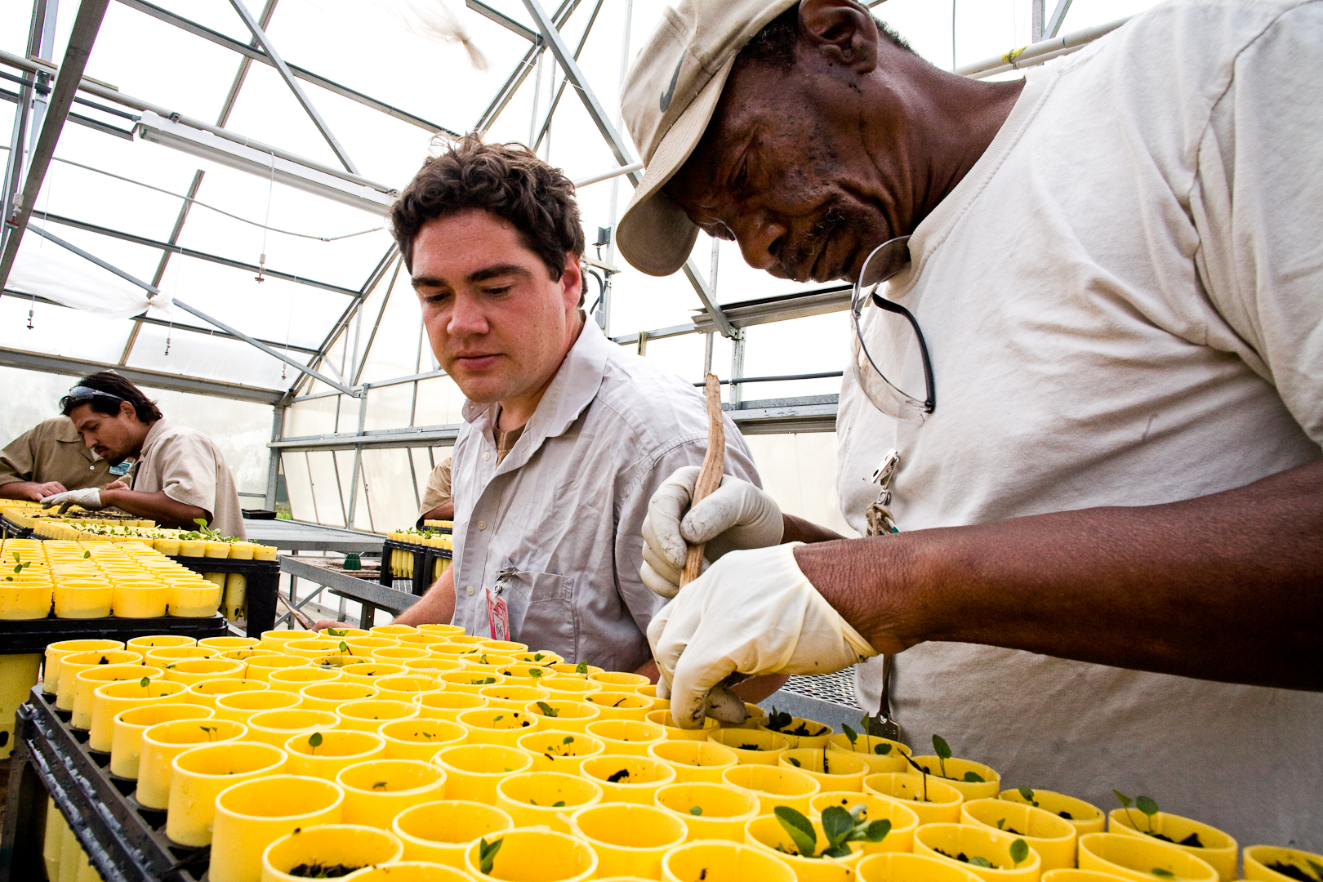

Slide 21
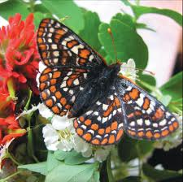
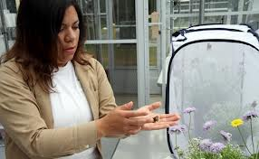
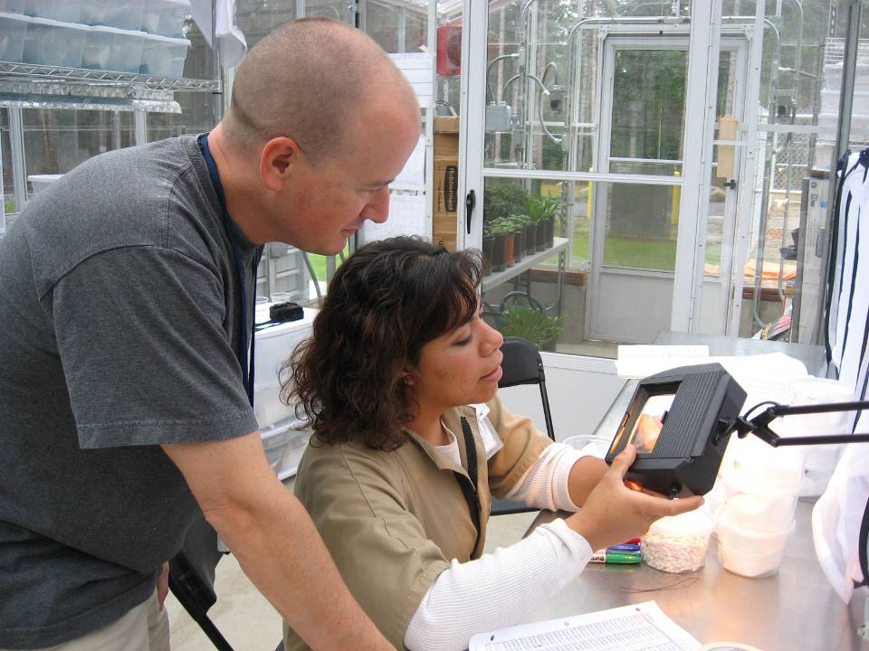
Taylor’s Checkerspot
Butterfly
Notes:
Butterfly Technician and Dennis

Slide 22
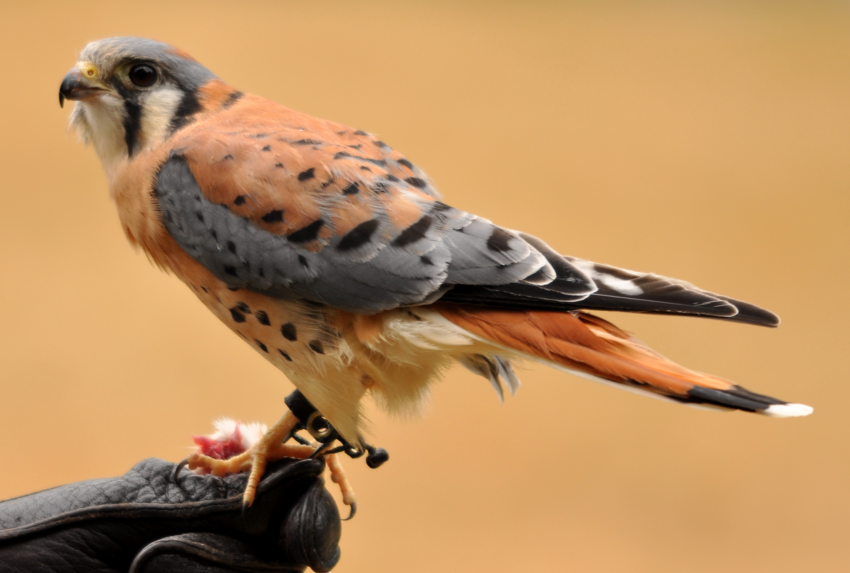
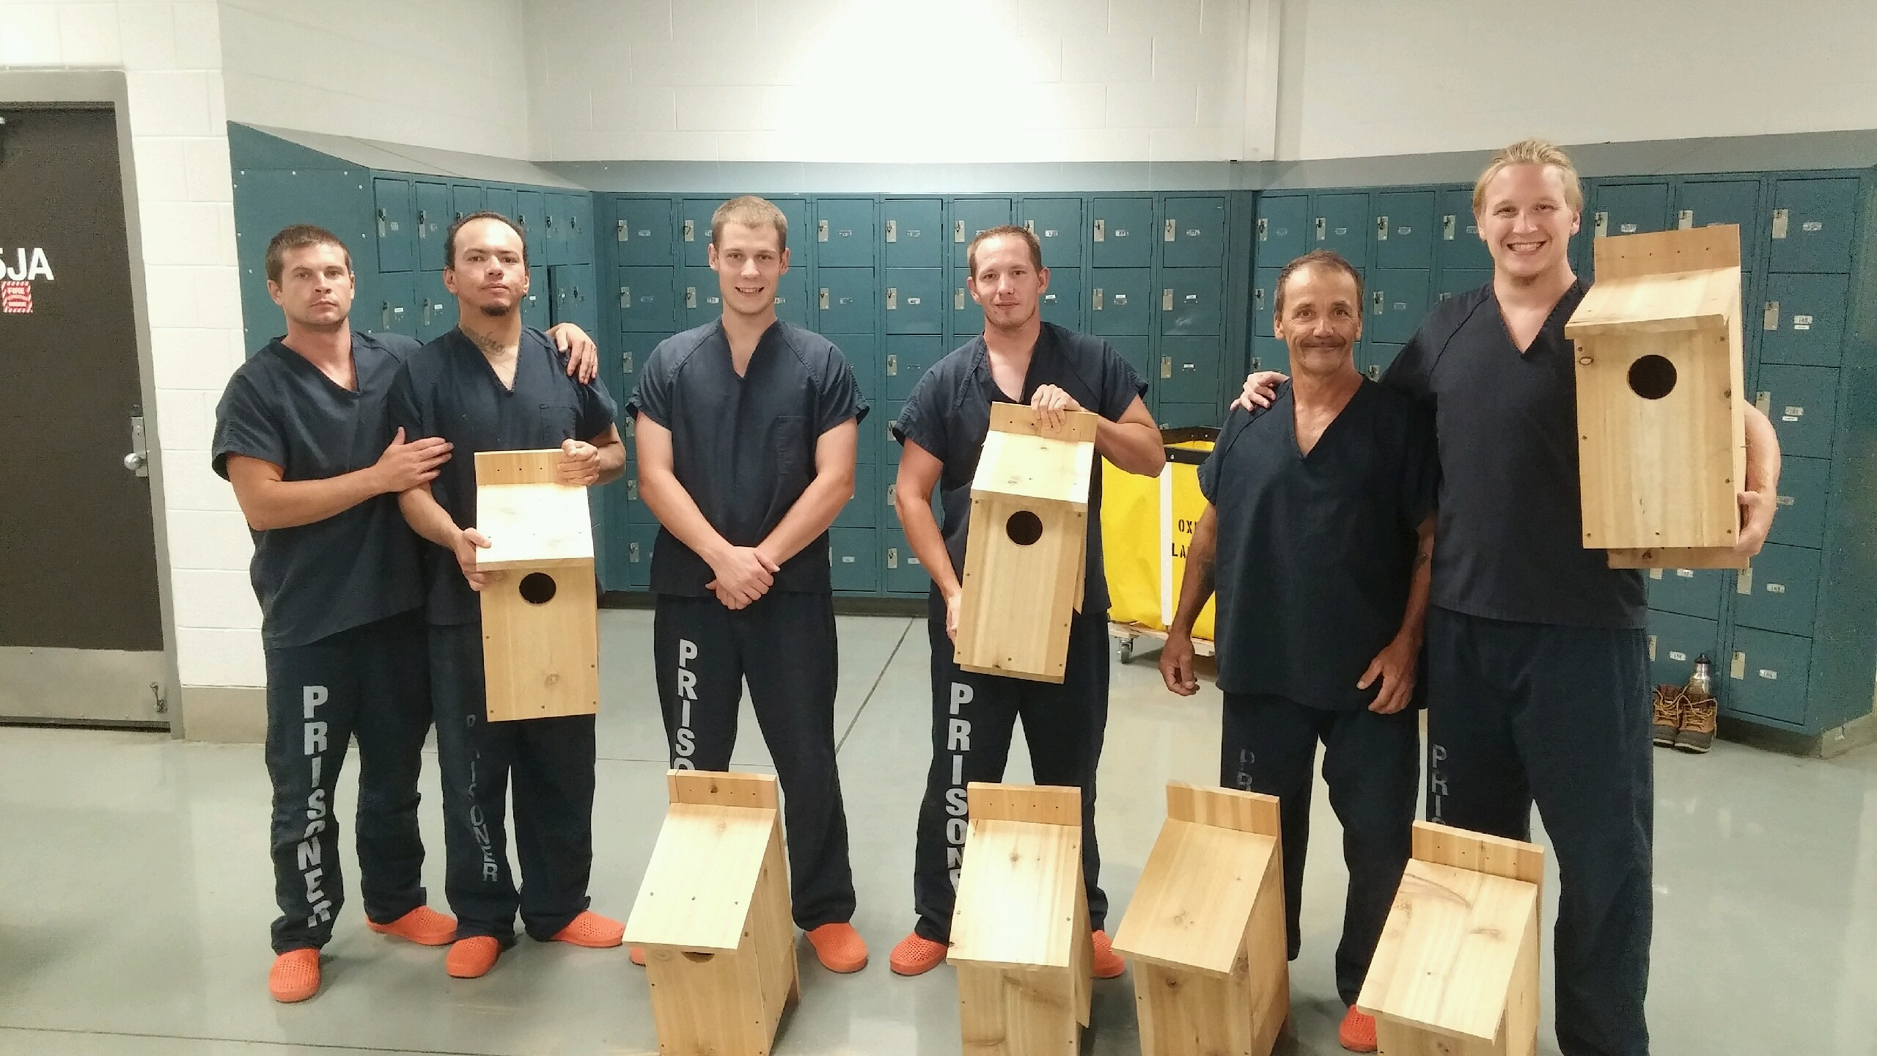
American Kestrel Boxes
Notes:
Goal to participate in national efforts to conserve American Ketral (Falco sparverius), native ot Uah. 14 boxes on jail propoert, will be montoryed by imates. Joines citizen science project by American Ketrel Partnershp, location, young, can band birds. By contributing – they join other citizens to understand why AK is declining and help researchers develop effective conservation strategies.

Slide 23

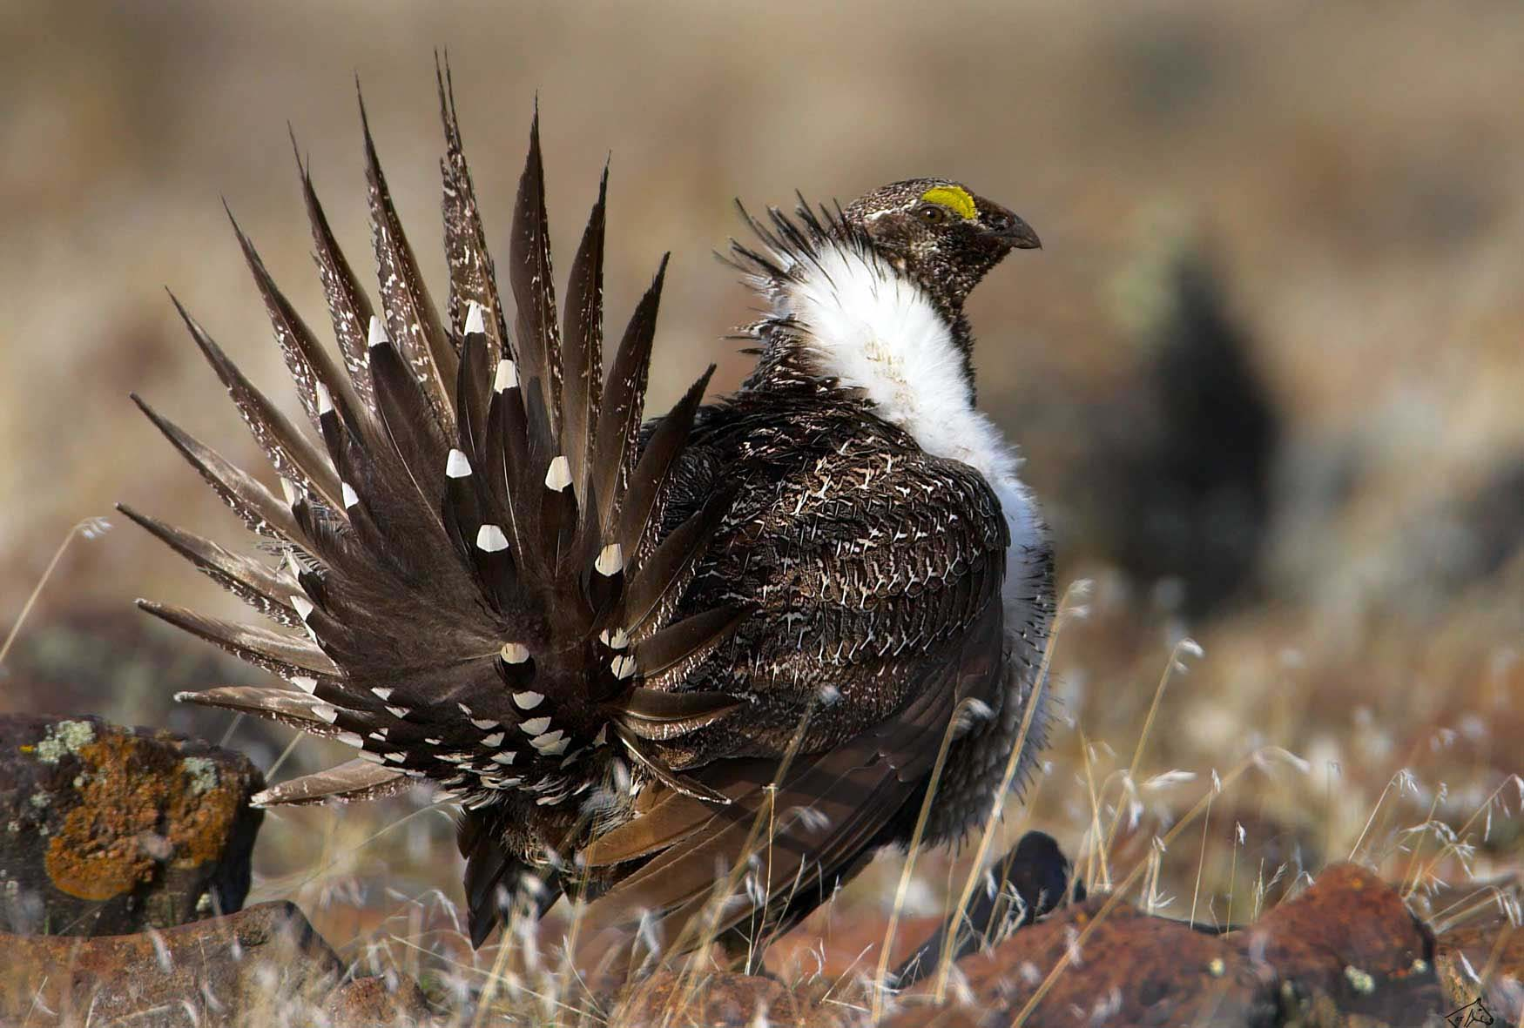
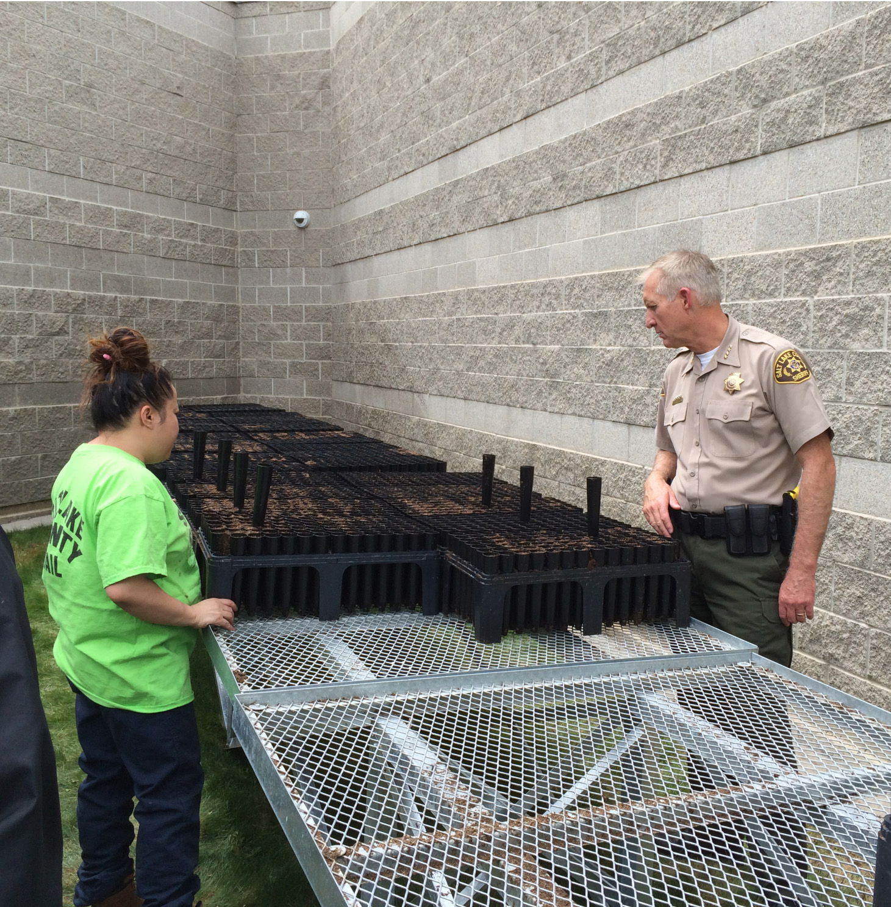
Sage Grouse Habitat Conservation

Slide 24
Conservation
Projects
Science
Lectures
Nature
Imagery
Academic Science
Conservation
Notes:
Overall structure: the CSME serves as a unique conduit. It is firmly routed in higher ed (science and education), and the public (formal and informal science education pathways). Assessment and evaluation are applied throughout; and though most projects are local and regional, we keep extension to national scales in mind.

Slide 25
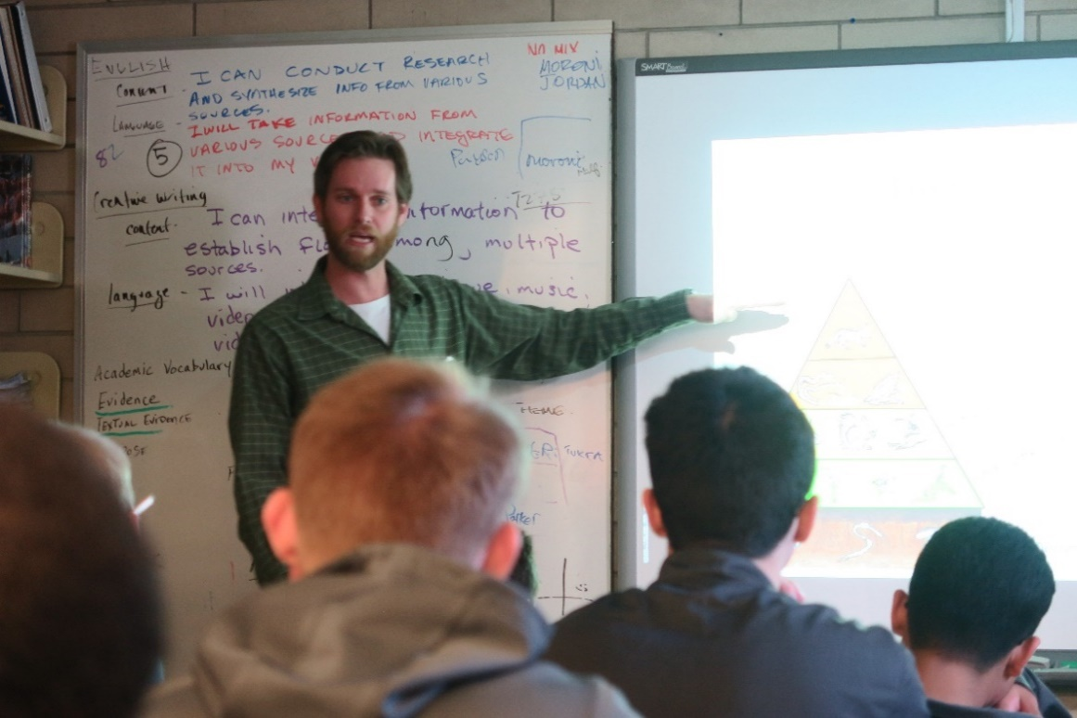
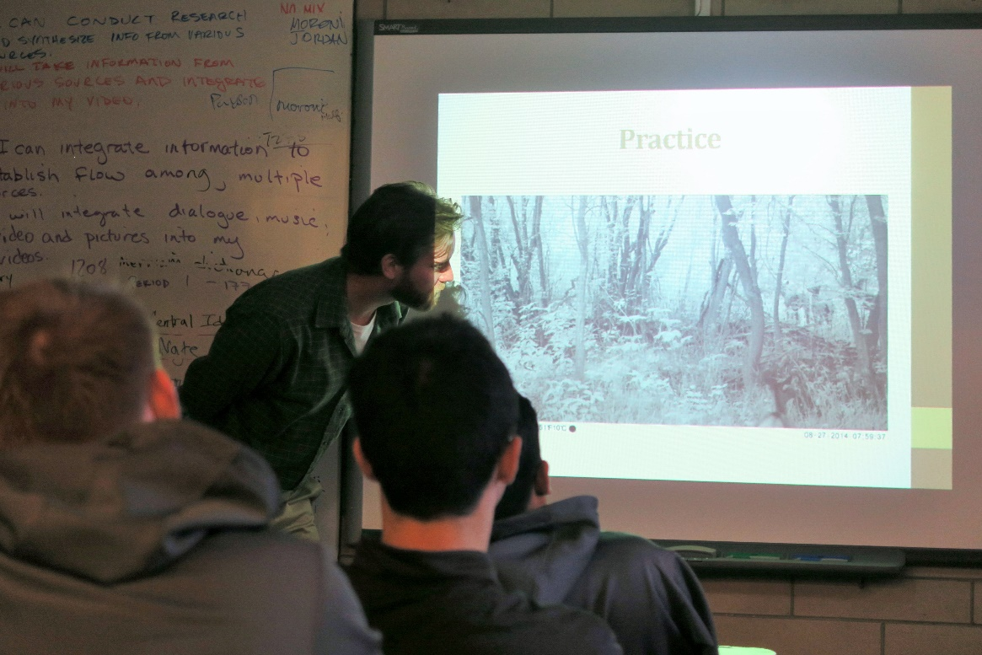
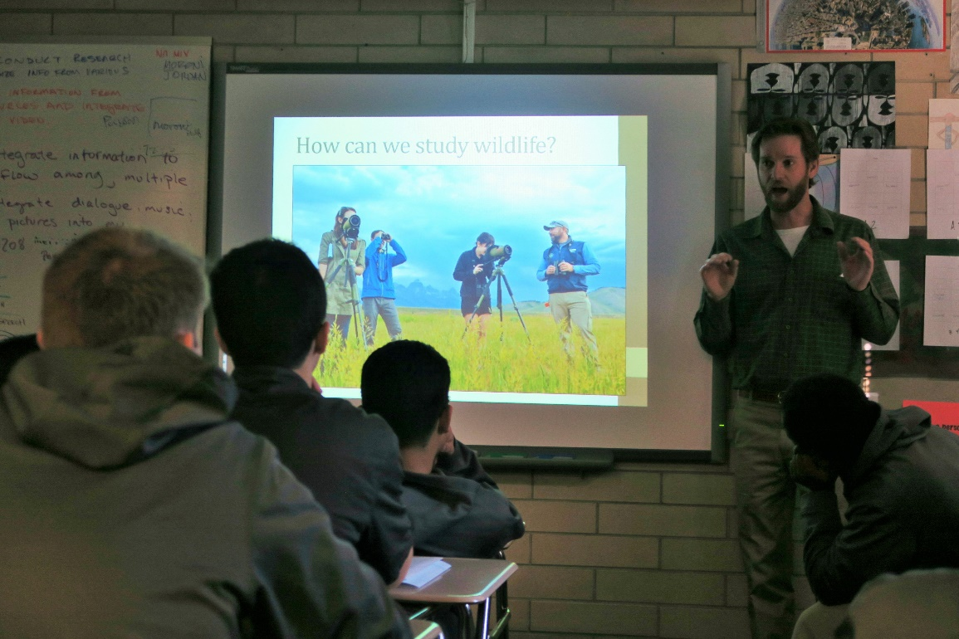
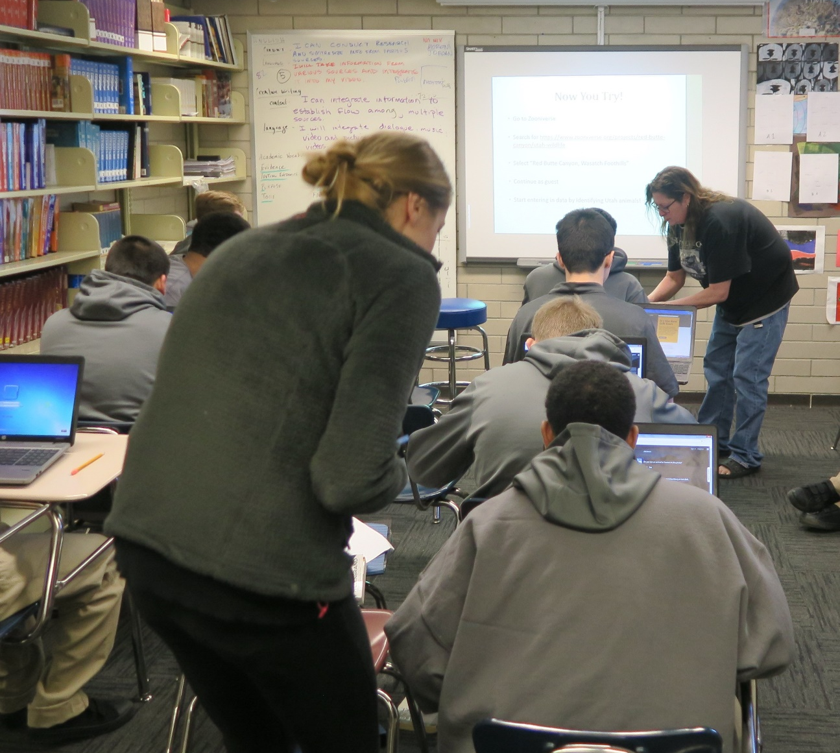
Mammal conservation
Mark Chenowyth, Biology Department graduate student

Slide 26
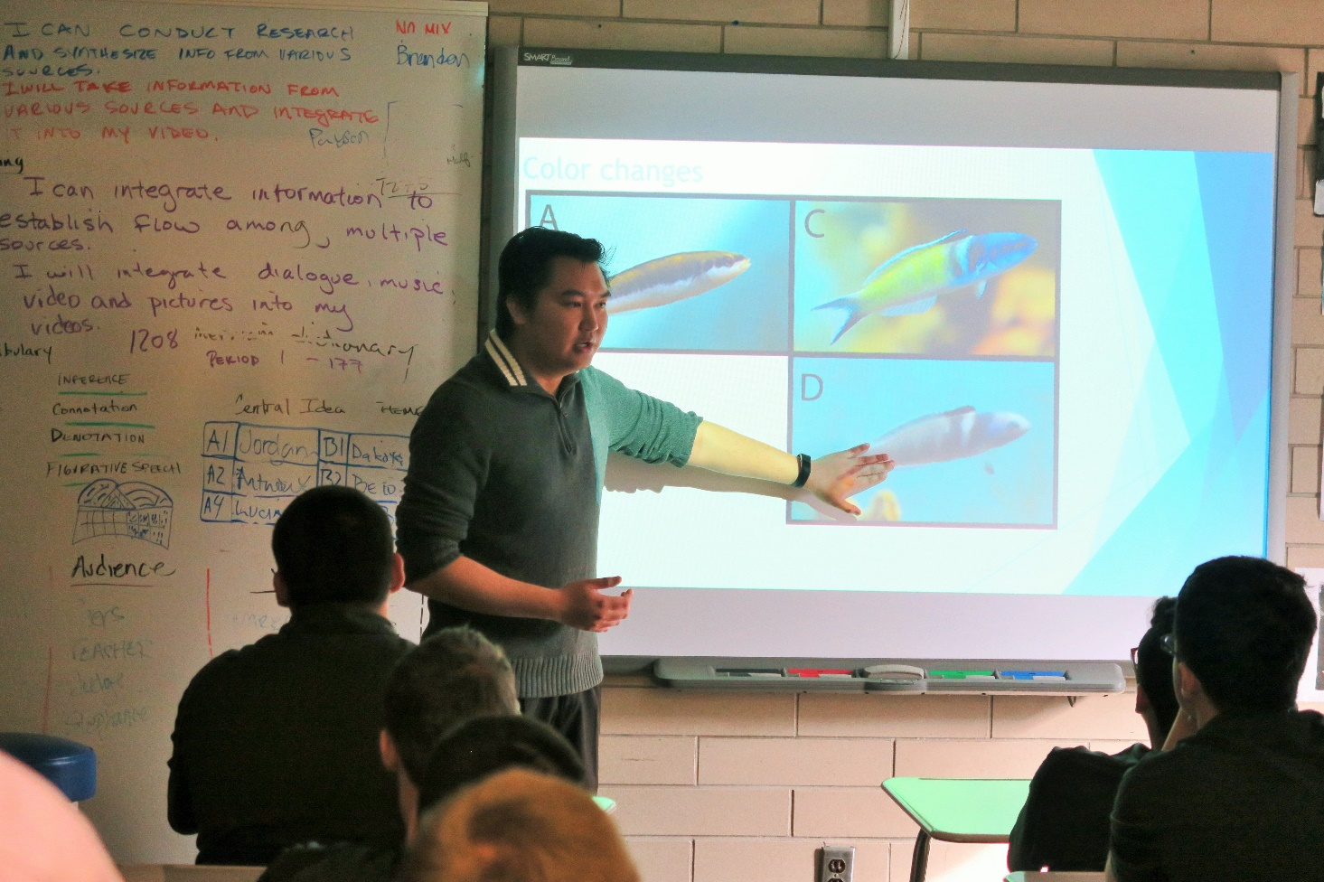
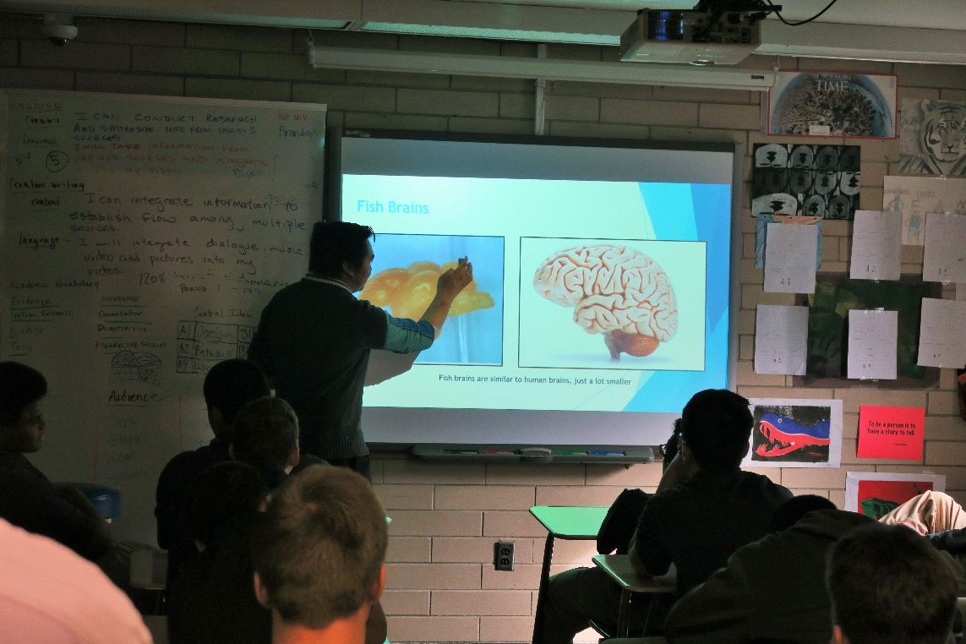
Toxic natural compounds and drug development
Danny Bae, Biology Department graduate student

Slide 27
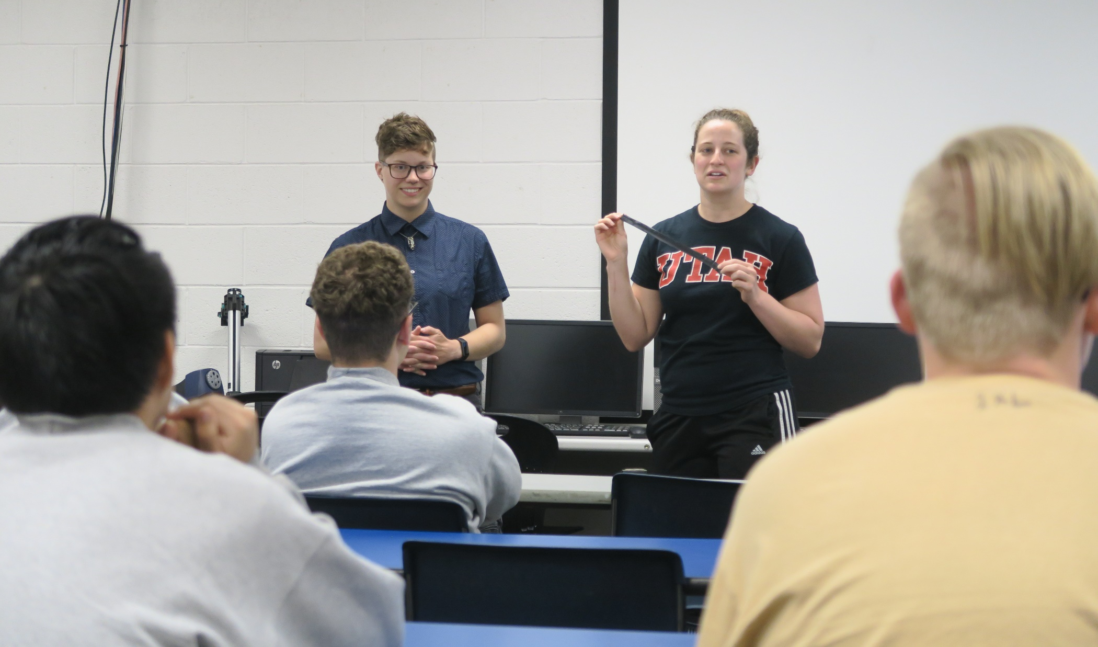
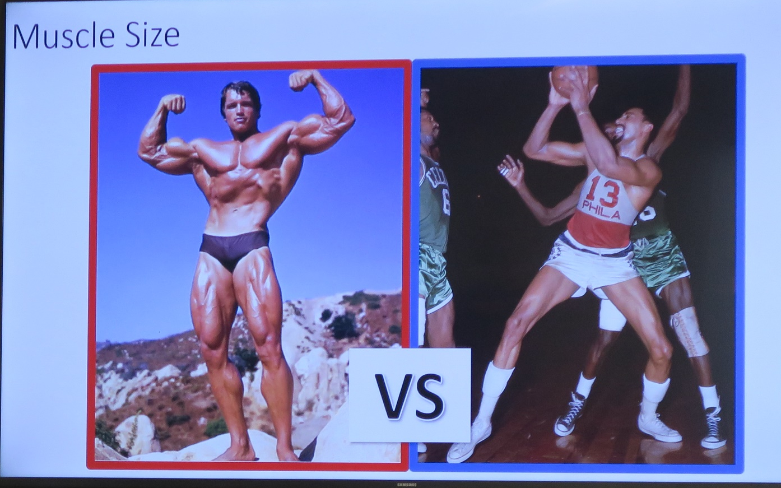
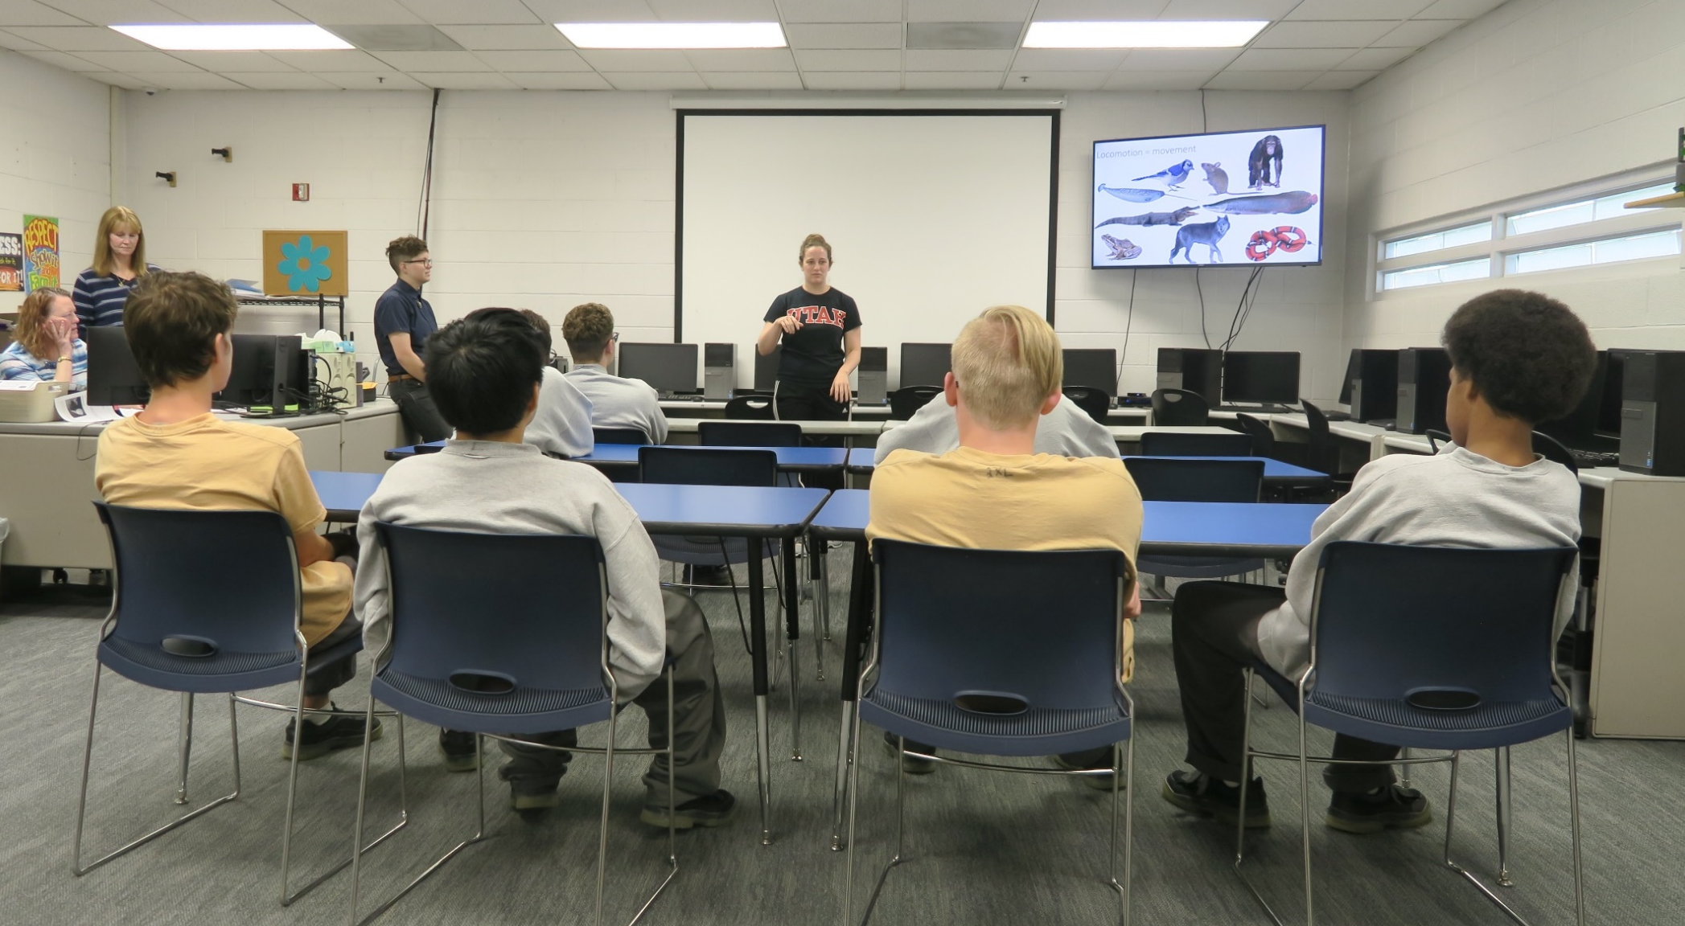
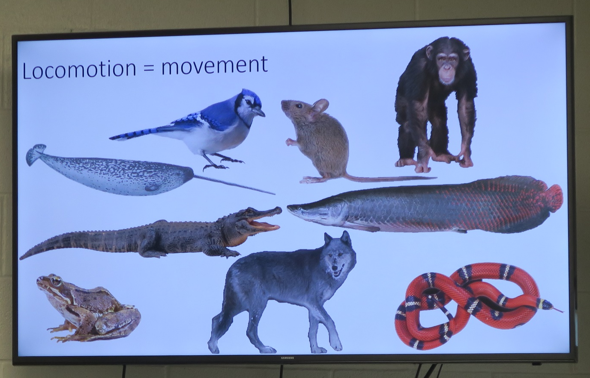
Amanda Cooper and Natalie Gotter
Extreme physiology and movement of the human body

Slide 28
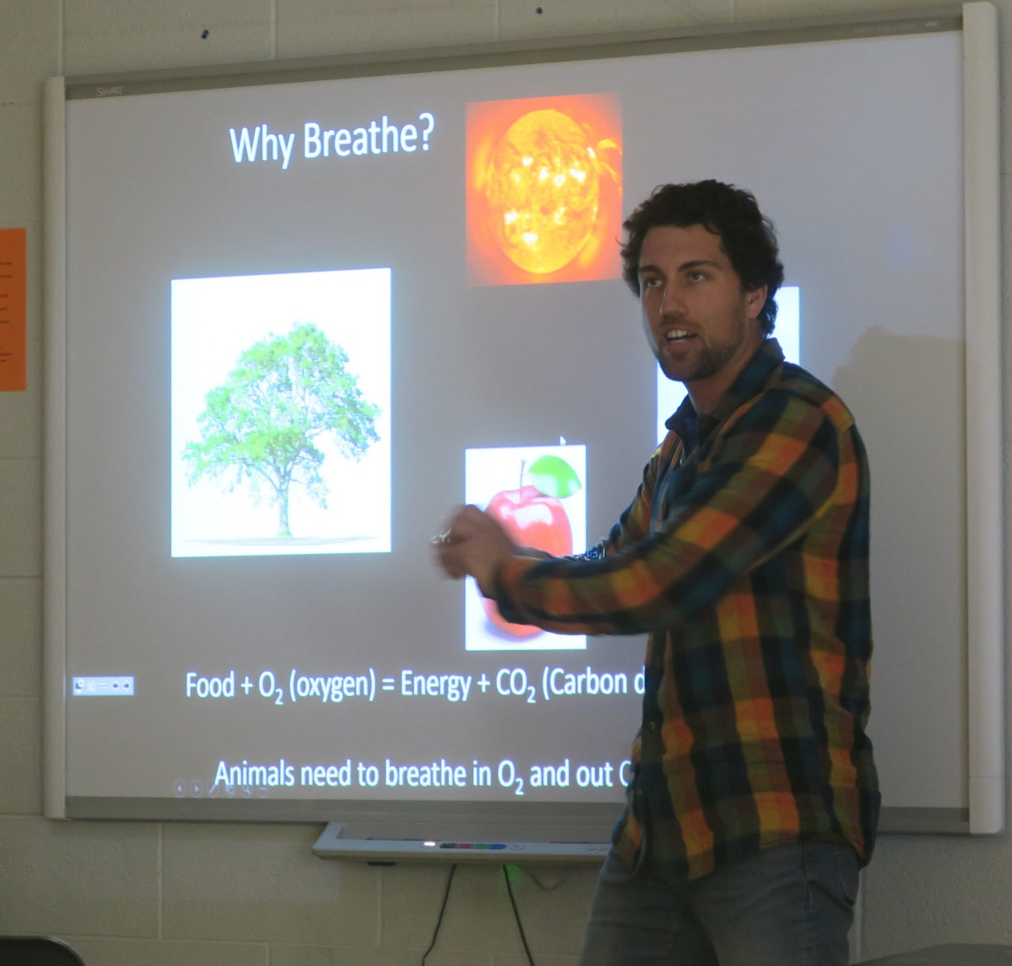
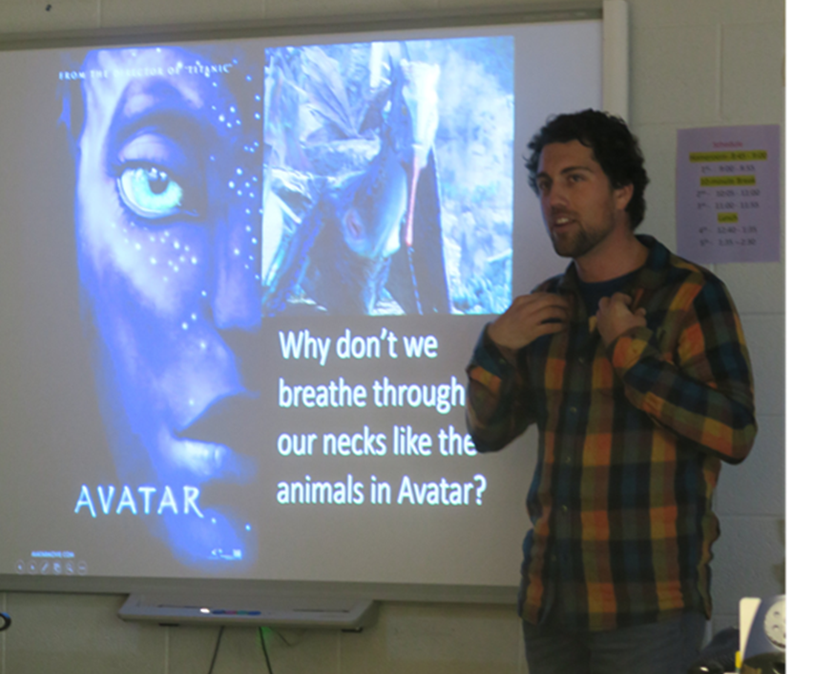
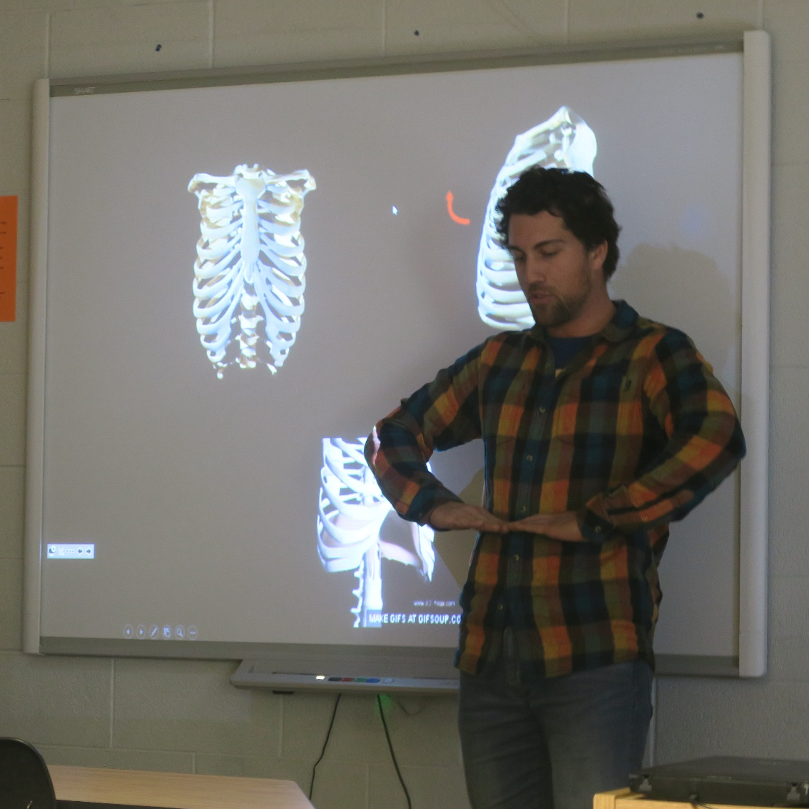
Evolution of the Lung
Bob Cieri, graduate student

Slide 29
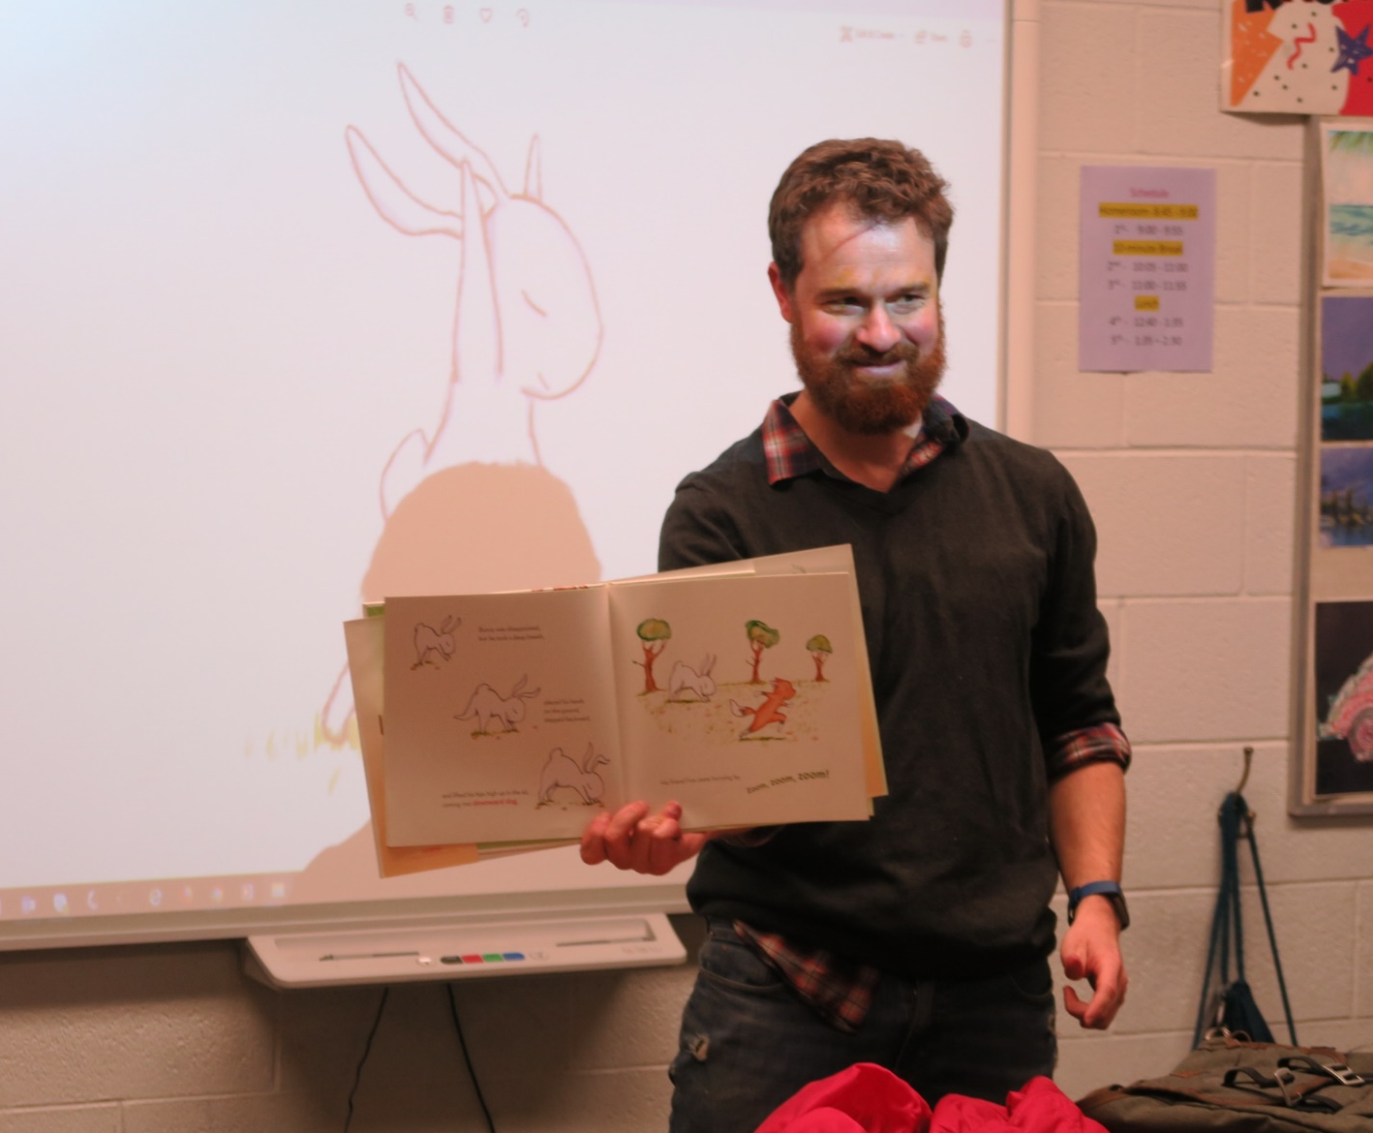
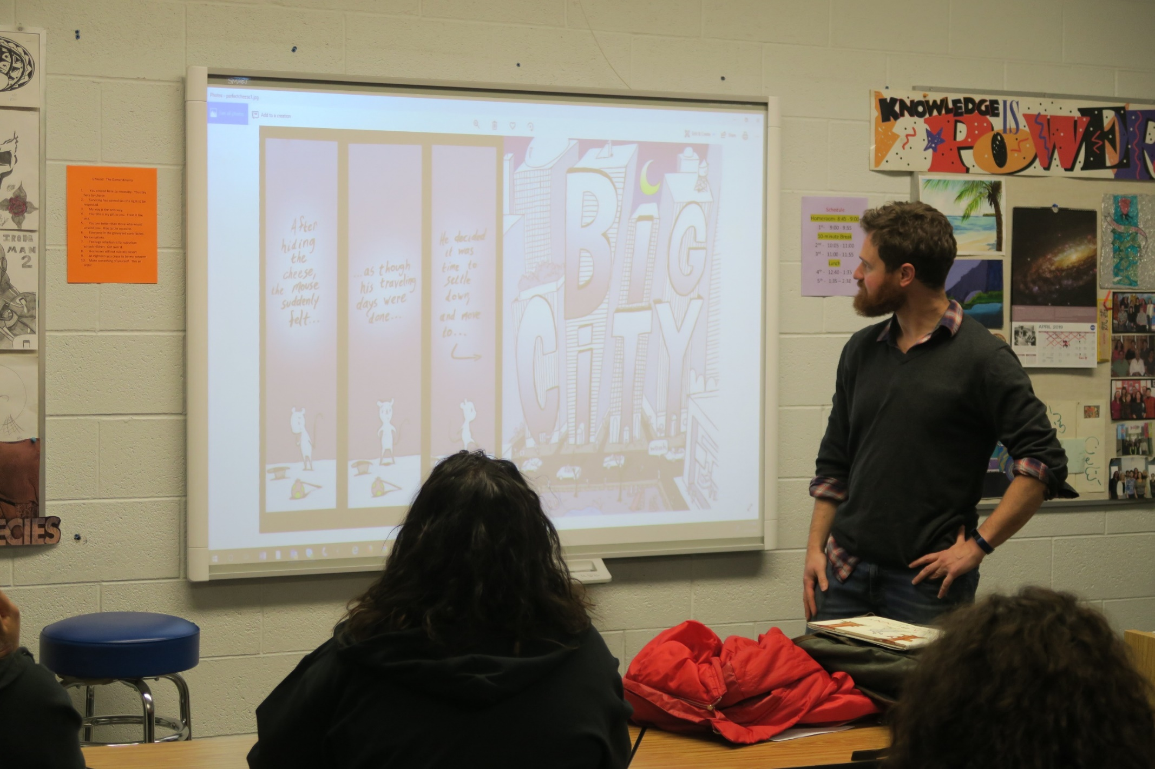
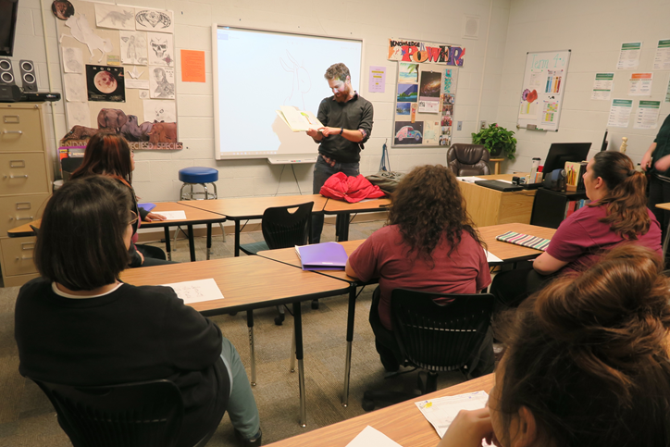
Brian Russo
Yoga movement

Slide 30
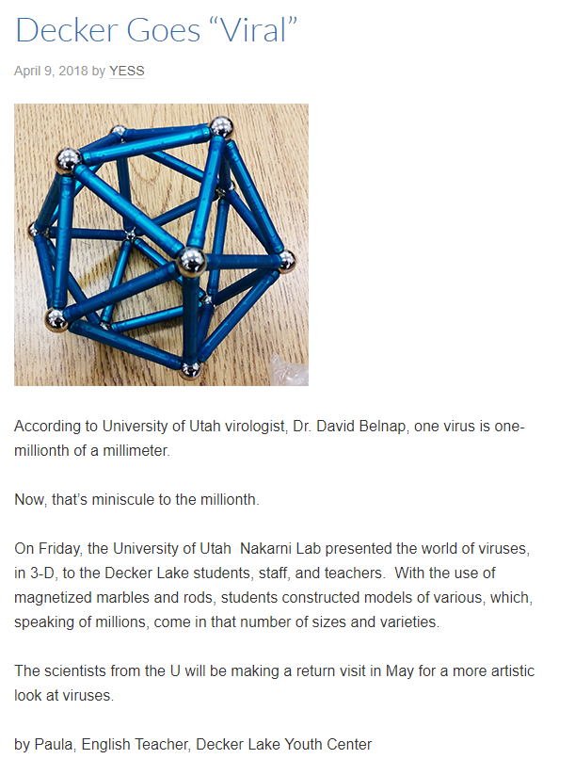
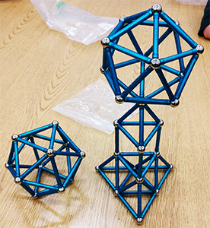
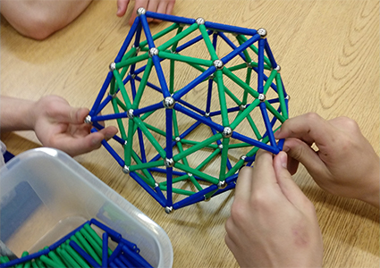
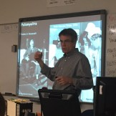
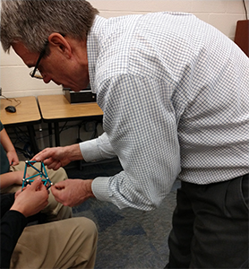
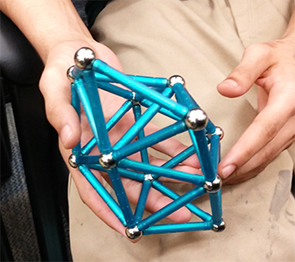
Experiential Workshop - Shapes of Viruses
David Belnap, Electron microscopist

Slide 31





Hands-on Lab: Metals and Magnets

Slide 32



Career Workshop - Materials Science
Krista Carlson, Professor

Slide 33

Total Lectures:
225 presentations, 6000 audience members

Slide 34
Conservation
Projects
Science
Lectures
Nature
Imagery
Academic Science
Conservation
Notes:
Overall structure: the CSME serves as a unique conduit. It is firmly routed in higher ed (science and education), and the public (formal and informal science education pathways). Assessment and evaluation are applied throughout; and though most projects are local and regional, we keep extension to national scales in mind.

Slide 35




Slide 36


Rachel Taylor
Community conservationist

Slide 37




Decker Lake Youth Center

Slide 38



Jordan River Commission

Slide 39


Slide 40

NASA Lectures

Slide 41




Slide 42



Slide 43




Slide 44

Responses to Astrobiology Presentation
National study
Science Knowledge Content

Slide 45

Responses to Astrobiology Presentation
National study
Identity, Value of Science, Future Actions

Slide 46
Conservation
Projects
Science
Lectures
Nature
Imagery
Academic Science
Conservation
Notes:
Overall structure: the CSME serves as a unique conduit. It is firmly routed in higher ed (science and education), and the public (formal and informal science education pathways). Assessment and evaluation are applied throughout; and though most projects are local and regional, we keep extension to national scales in mind.

Slide 47

Notes:
Cells are bare, no imagery at all.

Slide 48


Tree view
Wall view
R. Ulrich et al. 1984
Notes:
Not terribly surprising. You are no doubt familiaer with Psychological aspects of nature In1984, behavioral psychologist Roger Ulrich elegantly demonstrated that patients recovered faster, with fewer complaints, complications, narcotic drugs when they had a view of trees out the window versus a view of a concrete wall. Later research has shown that viewing nature or even nature imagery can bring down stress and anxiety and speed healing.

Slide 49

Notes:
Here I am checking out which image of nature might be most conducive to calm and serenity from Mr. Lopez, who has been in solitary for 18 months.
It is a struggle, both logistially and emotionally, for me to work with them. Most people- including the high level prison administrators say that we are wasting our time. These are the “worst of the worst,”, and are beyond help. Indeed, I can feel the many barriers – physical, social, class, race – but so far, we are persisting.
I hold in my mind the idea that my professors, the trees, have given me.

Slide 50


Notes:
Porposed nature vidoes. Cell block in half, installed projector on one side. Showed films

Slide 51

Nadkarni et al. 2017
Notes:
These are self-reported emotions.

Slide 52


26%
fewer violent
infractions

Slide 53


Slide 54
Conservation
Projects
Science
Lectures
Nature
Imagery
Academic Science
Conservation
Notes:
Overall structure: the CSME serves as a unique conduit. It is firmly routed in higher ed (science and education), and the public (formal and informal science education pathways). Assessment and evaluation are applied throughout; and though most projects are local and regional, we keep extension to national scales in mind.

Slide 55

Augment Science Content

Slide 56


Scientific skills and approaches
Notes:
Anecdotal evidence is not convincing.
Data is vital to confirm progress
Documented progress is needed to:
sustain positive behavior- staff, partners, offenders
helps with decision making, and
provides support for funding requests. (partner organizations will rely on data to write grants)
56

Slide 57

Team Work
Collaboration
Social Interactions
Notes:
Colleges and Universities- faculty and students
Conservation Organizations- the nature conservancy, zoos, etc
Other Agencies and Non-Profits- Department of Fish and Wildlife or Department of Natural Resources etc…
Community Groups- local animal shelters, Kiwanis, etc

Slide 58

Links to Nature
Larger Contributions
Notes:
Starting small is crucial!
You can always build on the project after you have had success at a small scale
It is easier to convince staff, offenders, and partners to get on board when you have demonstrated success,
Starting too large or without having the resources and partners you need, can result in failure damaging credibility; making it difficult to build momentum for future projects
Look for partners that can provide the expertise you are missing i.e. composting experts at cooperative extension can advise on setting up a successful compost operation.

Slide 59

Self Esteem and Esteem from Others
Notes:
Soon after then-Superintendent Dan Pacholke and his staff were looking to expand the prison and were told they needed to reduce the amount of water used and wastewater generated, or pay $1.3 million to upgrade the wastewater system.
They began having offenders scrape the food off their plates and started capturing rainwater.
Less than a year later engineers reported that the prison expansion could move forward – without having to upgrade the wastewater system.
The staff started looking for other small ways they could reduce waste.
They stopped purchasing paper cups and trash can liners asking , “Why are we purchasing items just so we can throw them away?” Suddenly, sustainability was no longer an expensive feel-good initiative – it was a money saver.
College researchers, meanwhile, welcomed the opportunity to work with a population that has historically been isolated from nature and science.
In June 2008 we formalized the partnership and created the Sustainable Prisons Project.

Slide 60




Science
CNN News - Anderson Cooper
Frontiers in Ecology and Evolution
Conservation in Practice
Orion
Discover Magazine
New York Times
The Olympian
Russian Newsweek
Mother Jones
NPR Radio
PBS television
Playboy Magazine
Notes:
The ecologicalprograms at Cedar Creek provided intellectual stimulation for many inmates, staff, and researchers alike. Using myself as an example, the program has not only helped me co-author my first scientific publication but it has also stimulated me to look more closely at ecological issues in my everyday life. I am going back to school to get my Ph.D in Biochemistry and realize that there is a lot of potential for impact by collaborating with the ecological scientists to help design more solutions to our environmental problems.
The small steps we took at Cedar Creek had a very noticable positive environmental impact that I believe can be replicated at any enforced residential institution in the country. An inter-agency bond between DOC and Evergreen State College has formed and is testing the idea of expanding the composting techniques to several other institutions in Washington.
The positive press that the program brought to Cedar Creek helps both the prison and the field of ecology.

Slide 61
Conservation
Projects
Science
Lectures
Nature
Imagery
Academic Science
Conservation
Notes:
Overall structure: the CSME serves as a unique conduit. It is firmly routed in higher ed (science and education), and the public (formal and informal science education pathways). Assessment and evaluation are applied throughout; and though most projects are local and regional, we keep extension to national scales in mind.

Slide 62

Graduate and
Undergraduate students
Theses
Independent Learning Contracts
Internships
“Broader Impacts”

Slide 63


Slide 64


Slide 65
MISSION STEMCAP
Stanford University Consensus
GRAND
CHALLENGES
Climate Disruption
Extinctions
Loss of Biodiversity
Pollution
Population and
Consumption Growth

Slide 66
MISSION STEMCAP
To understand and propose solutions for our Grand Challenges
Through study, reflection and exchange
GRAND
CHALLENGES
STEMCAP RESOURCES
STUDENT RESOURCES
TEACHER RESOURCES

Slide 67
MISSION STEMCAP
GRAND
CHALLENGE
STEMCAP RESOURCES
STUDENT RESOURCES
TEACHER RESOURCES

Slide 68
MISSION STEMCAP
GRAND
CHALLENGE
STEMCAP RESOURCES
Frame the challenge
Film
Science Right Now! lecture
Art-science workshop
STUDENT RESOURCES
TEACHER RESOURCES
Podcast for public
Correspondence to individuals
[scientist, artist, politician, family, “hero”, self]
Readings and seminars
Podcast production training

Slide 69
MISSION STEMCAP
ANY
CHALLENGE
STEMCAP RESOURCES
STUDENT RESOURCES
TEACHER RESOURCES

Slide 70
1. What other activities would fulfill your missions?
2. How can we best evaluate impacts?
Notes:
On of my favorite poets, the Indian write, Rab tagore, wrote:The tapesty of life’s story is woven with the threads of life’s ties, ever breaking and joining.
So today will take a look at one of life’s tapestry – forest ecosystems – and examine those threads.
Start by introducing myself, my background, my research
Discuss ways of communicating, espec to non-traditional audiences,
Put some thoughts out on why trees are so special
End with an exercise to articulate our favorite trees, and the threads that might join in discovering that.

